Slide 1
Linear Algebra
Lecture 1

Slide 2
12
18
24
30
36
42

Slide 3
12 18 24 30 36 42

Slide 4
[12 18 24 30 36 42]

Slide 5
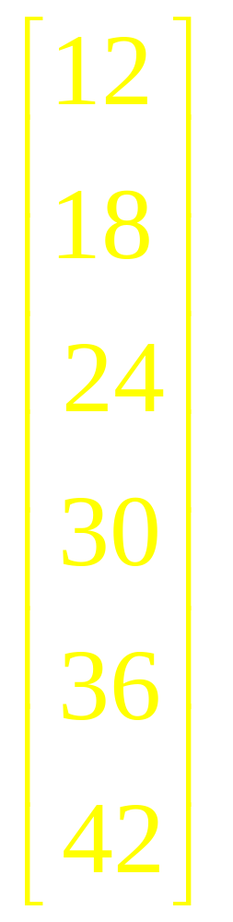
12
18
24
30
36
42

Slide 6
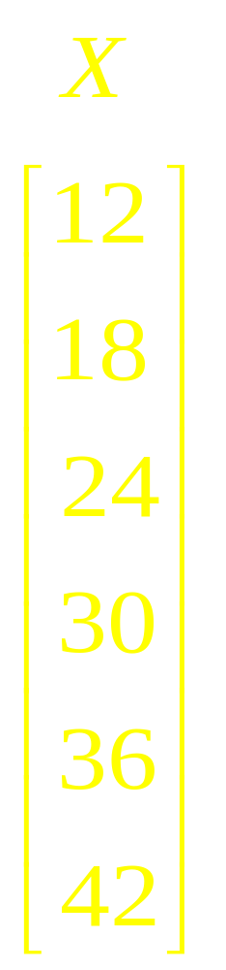



Slide 7
What is Algebra?

Slide 8
What is
Linear
Algebra?

Slide 9
Applications
Computer Graphics,
Electronics,
Chemistry,
Biology,
Differential Equations,
Economics,

Slide 10
Applications
Business,
Psychology,
Engineering,
Analytic Geometry,
Chaos Theory,
Cryptography,

Slide 11
Applications
Differential Equations,
Fractal Geometry,
Game Theory,
Graph Theory,
Linear Programming,
Operations Research

Slide 12
Why Use Lin Algebra?
Formalizing
Structuring
Organizing
Presenting
Manipulating

Slide 13
Using Linear Algebra
The solutions of systems of linear equations
The vectors of physics, such as force, acceleration.
Binary code, an example of a vector space, has applications in computer Sciences

Slide 14
Using Linear Algebra
Solutions to specific systems of differential equations
Statistics uses linear algebra.
Signal processing uses linear algebra.

Slide 15
Using Linear Algebra
Linear Algebra is part of and motivates much abstract algebra. Vector spaces form the basis from which the important algebraic notion of module has been abstracted.

Slide 16
Using Linear Algebra
Vector spaces appear in the study of differential geometry through the tangent bundle of a manifold.

Slide 17
Using Linear Algebra
Many mathematical models, especially discrete ones, use matrices to represent critical relationships and processes.

Slide 18
Using Linear Algebra
This is especially true in engineering as well as in economics and other social sciences.

Slide 19
Course Segments
Linear Equations (8)
Matrix Algebra (6)
Determinants (3)
Vector spaces (8)
Eigenvalues & Eigenvectors (8)
Orthogonality (7)….+2+3

Slide 20
Course Objectives
To master techniques for solving systems of linear equations
To introduce matrix algebra as a generalization of the single variable algebra of high school.

Slide 21
Course Objectives
To build on the background in Euclidean space and formalize it with vector space theory.
To develop an appreciation for using linear methods in a variety of applications.

Slide 22
Course Objectives
To relate linear methods to other areas of mathematics such as calculus and, differential equations.

Slide 23
Recommended Books
Linear Algebra and its Applications (3rd Edition)
by David C. Lay
Contemporary Linear Algebra by H. Anton and R. C. Busby

Slide 24
Recommended Books
Introductory Linear Algebra (8th Edition)
by H. Anton and C. Rorres
Introduction to Linear Algebra (3rd Edition)
by L. W. Johnson, R.D. Riess and J.T. Arnold

Slide 25
Recommended Books
Linear Algebra (3rd Edition)
by S. H. Friedberg, A.J. Insel and L.E. Spence
Introductory Linear Algebra with Applications (6th Edition) by B. Kolman

Slide 26
Some useful Web sites
www.laylinalgebra.com
www.wiley.com/college/anton

Slide 27
Linear Algebra
Lecture 1

